Slide 1

Problems with four operations

Slide 2
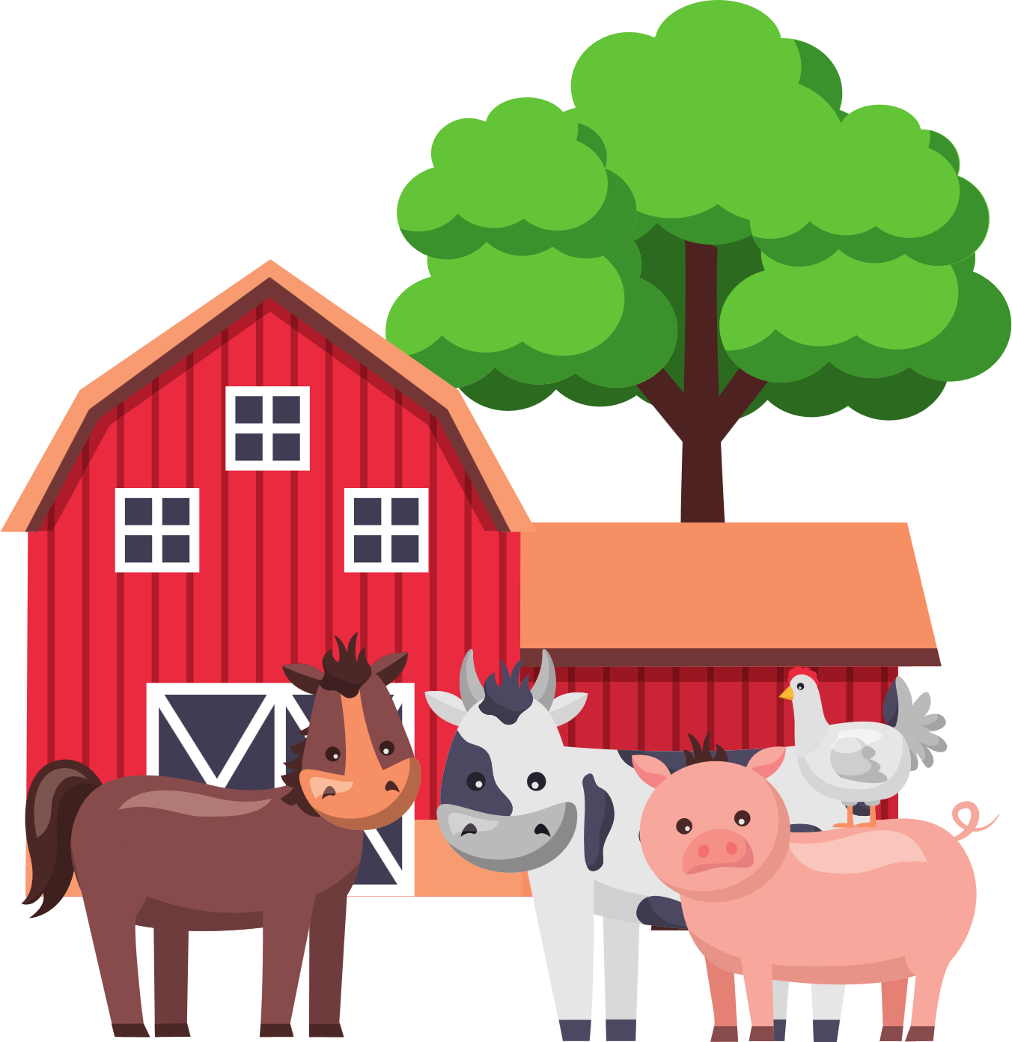

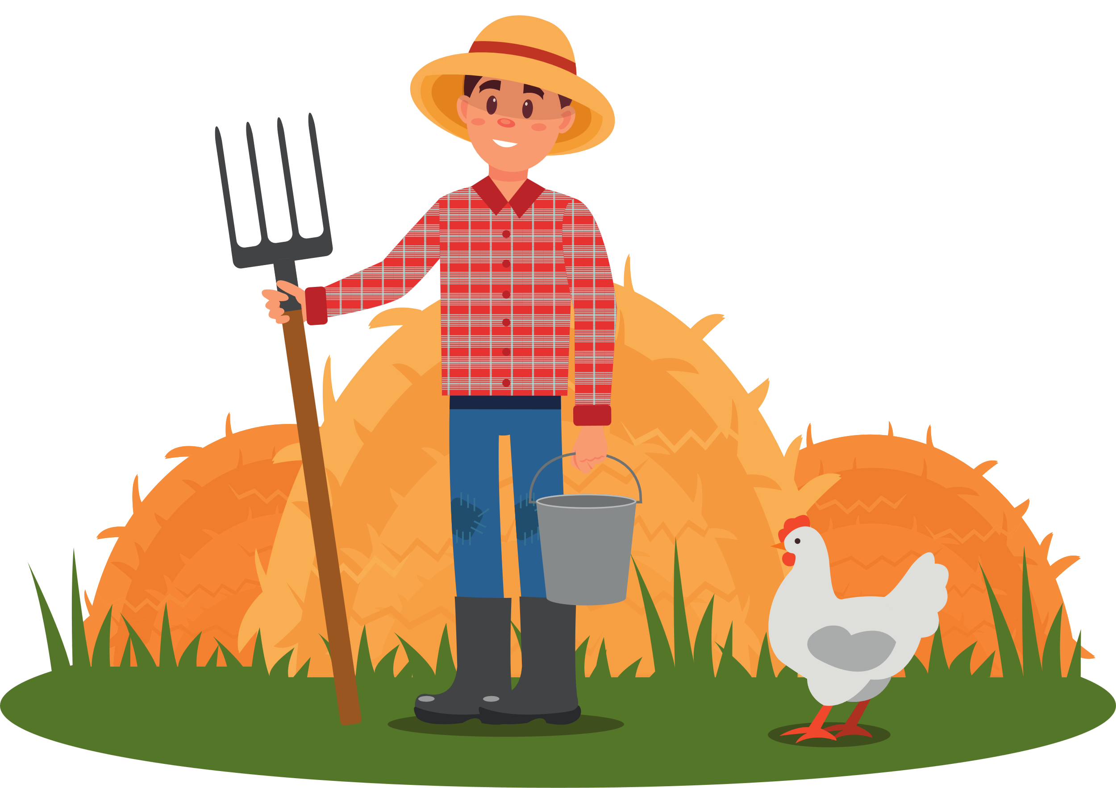
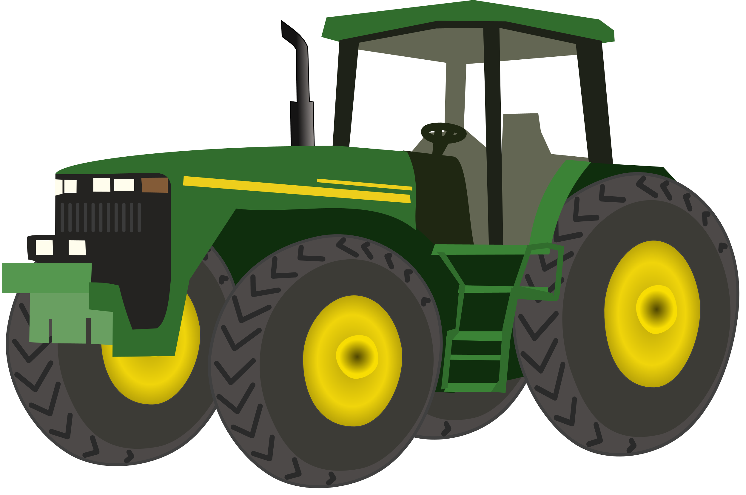
Farm stories

Slide 3
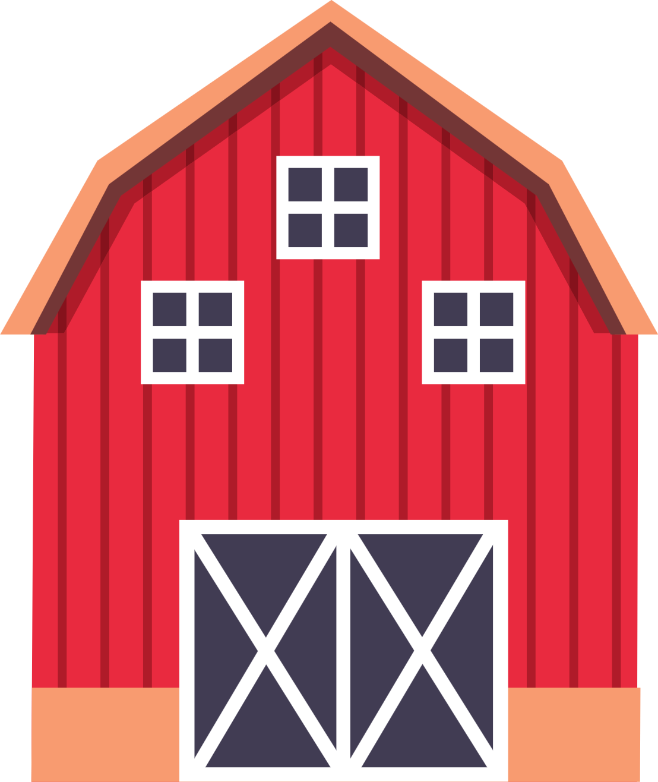
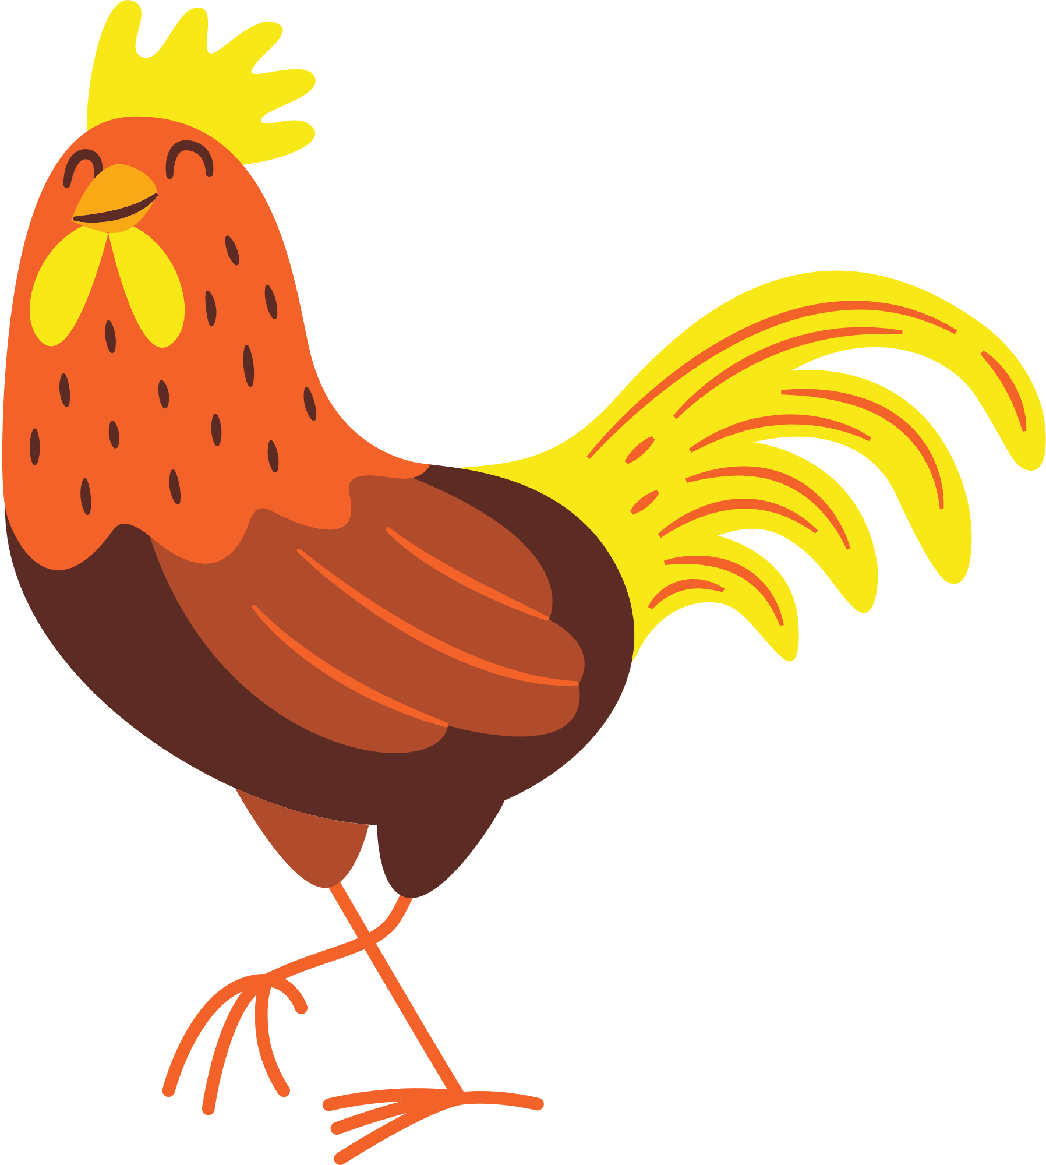
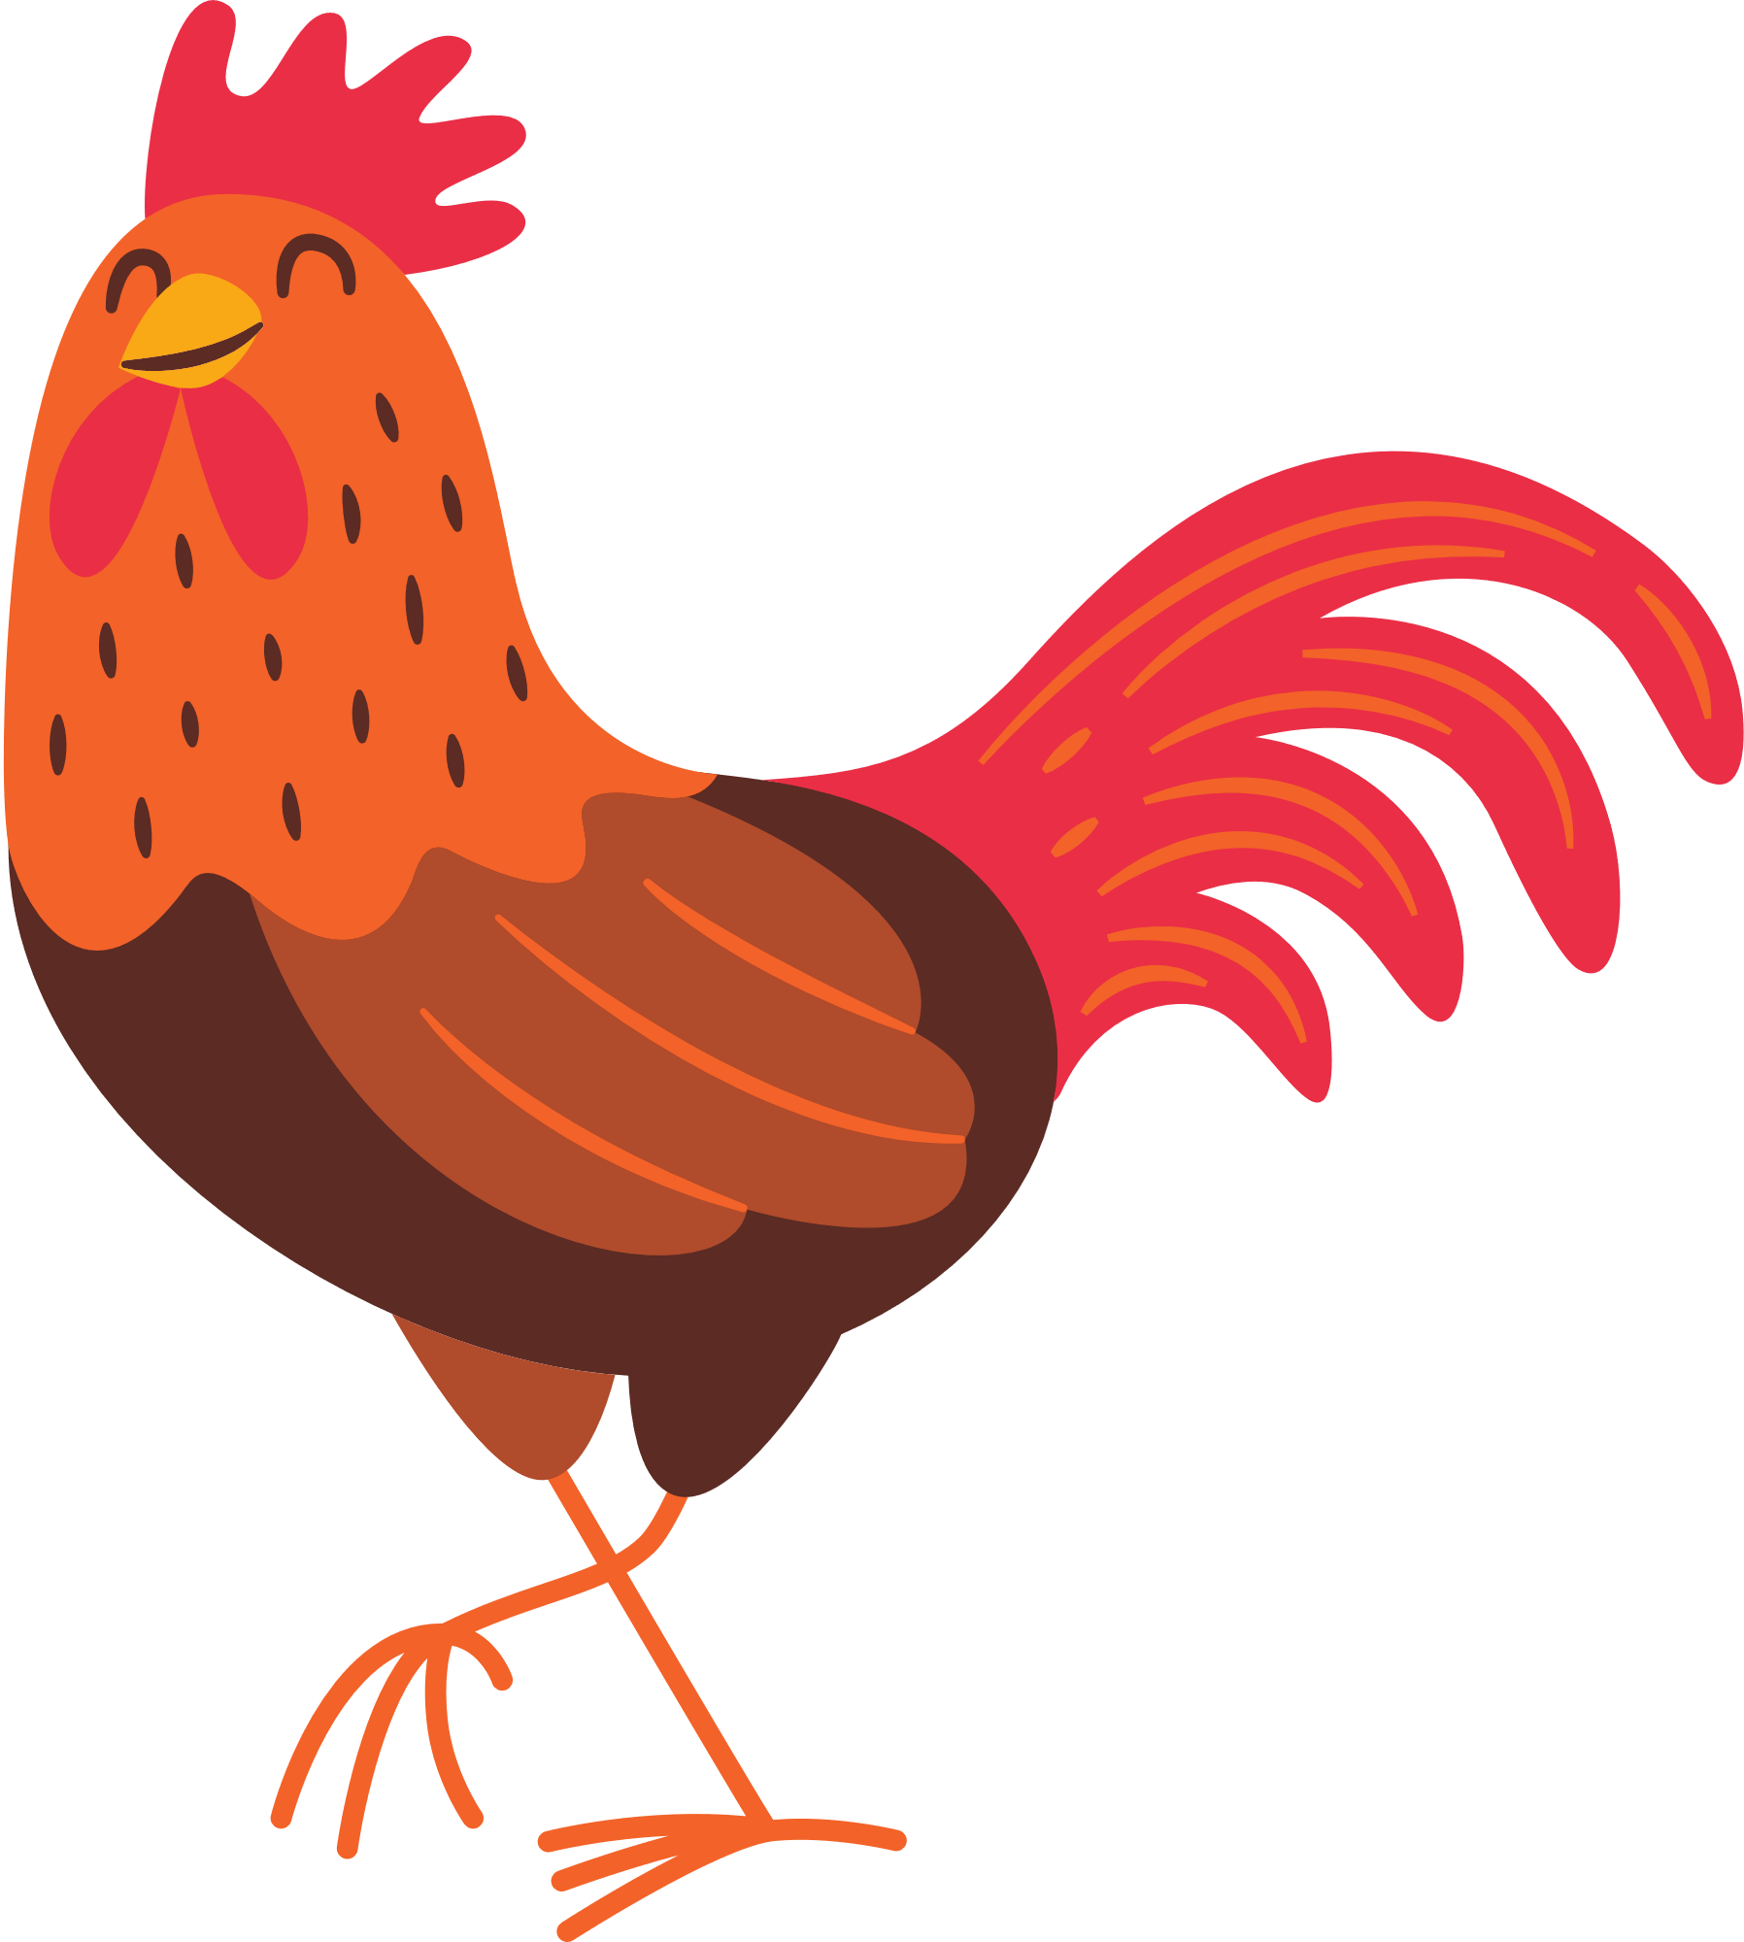
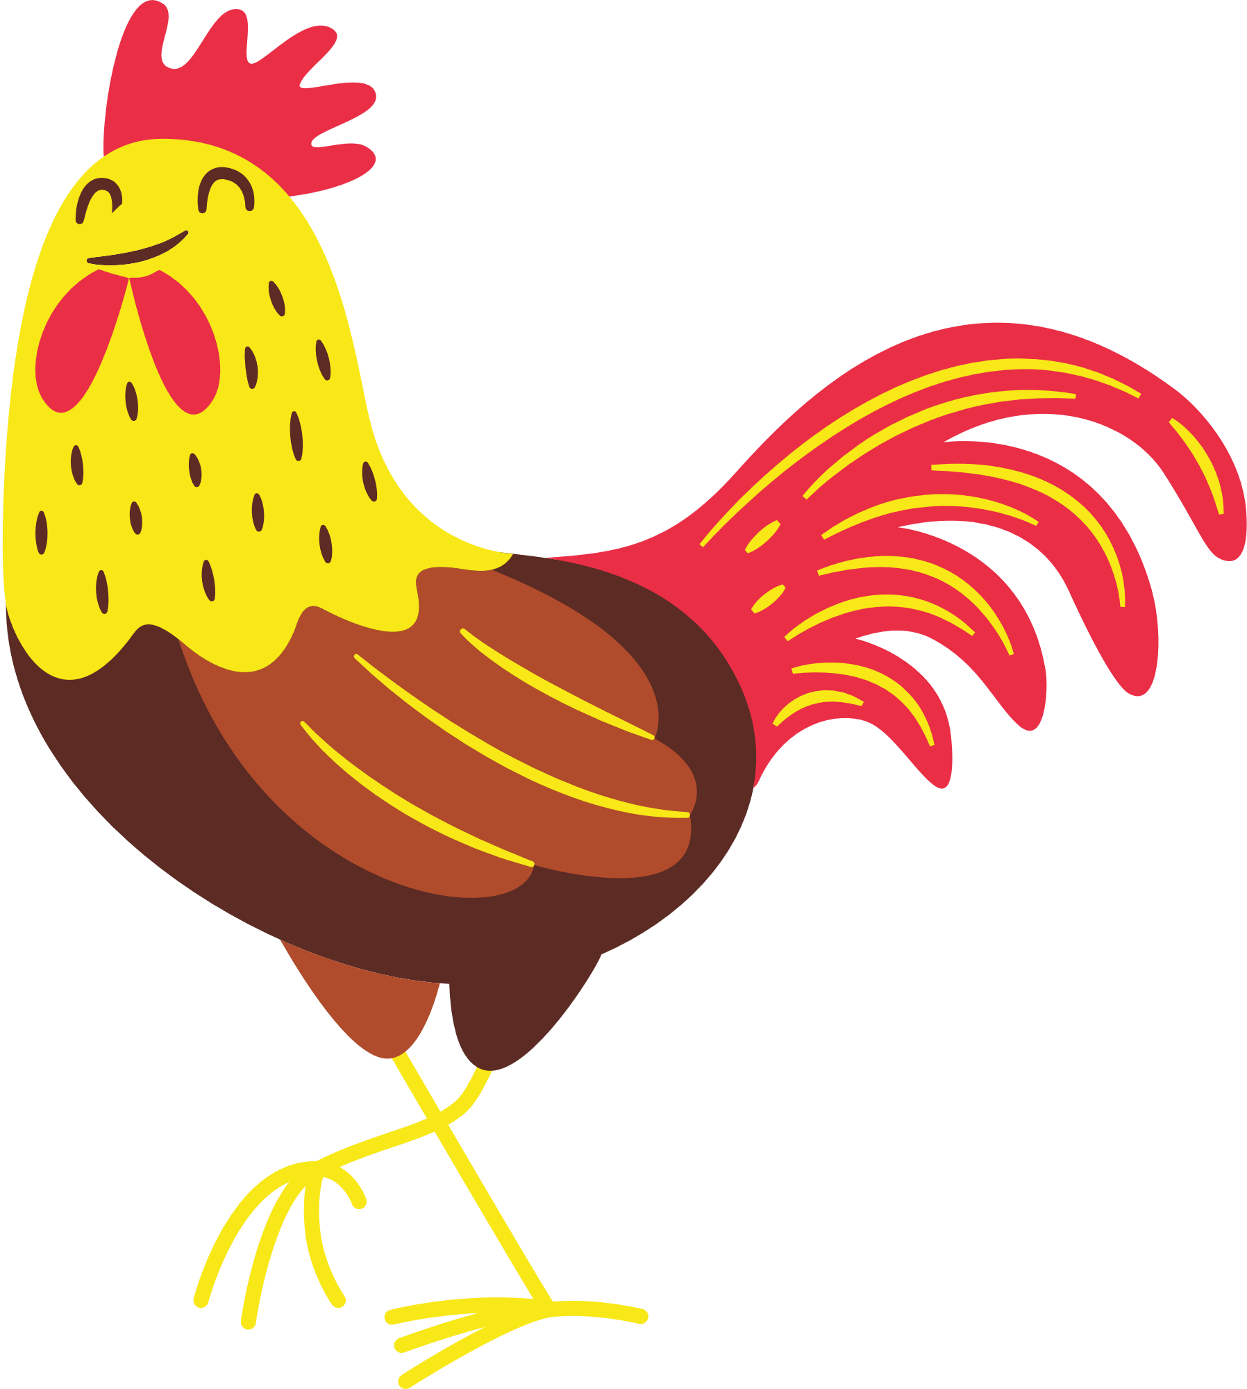
"There are 5 roosters singing in the field. One rooster decides to join its friends in the neighboring field. How many roosters are left singing in the field?"

Slide 5
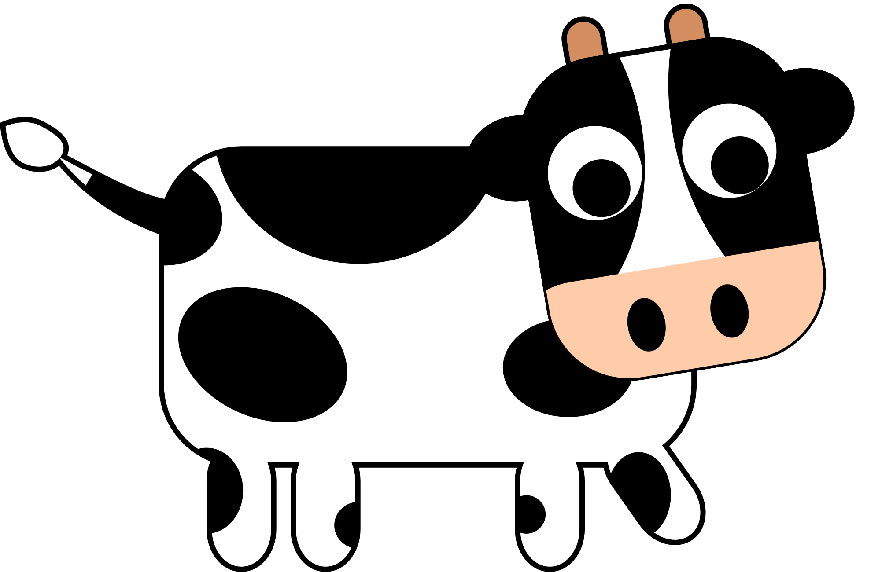
there are 4 grazing cows in the field. two cows go to graze under a tree. how many cows are left?

Slide 7
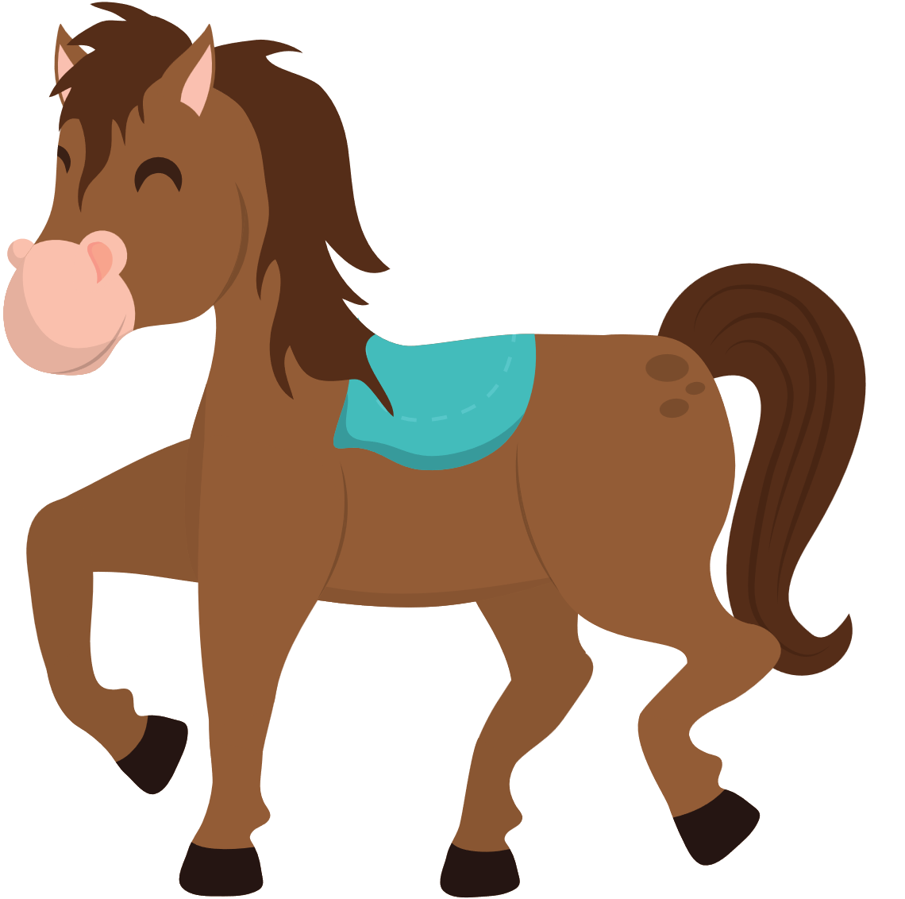
A horse family is galloping in the field. Two more horse families galloped from the nearby meadow to play with . How many horses are there in total?

Slide 9
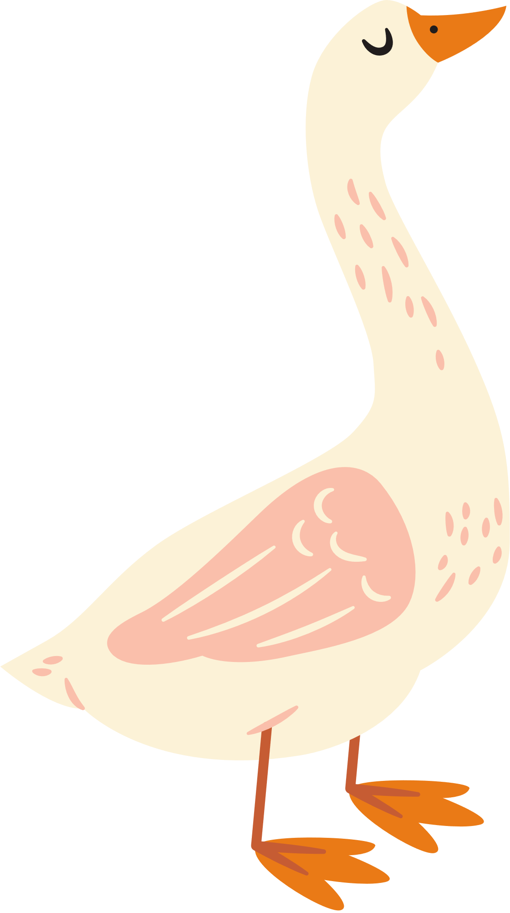
There are 9 ducks walking in the field. They belong to 3 duck families. One of the duck families decides they want to go back to the pond. How many ducks are left in the field?

Slide 11






2022-1-BG01-KA220-SCH-000085065
School subject: Mathematic
Students’Age: 8 years
Topic: Problems with four operations
Credits: Antalya Directorate Of Education
All media are within the EU intellectual property law.
The European Commission’s support for this publication does not constitute an endorsement of the contents, which reflect the views only of the authors, and the Commission cannot be held responsible for any use which may be made of the information contained herein.

